Slide 1






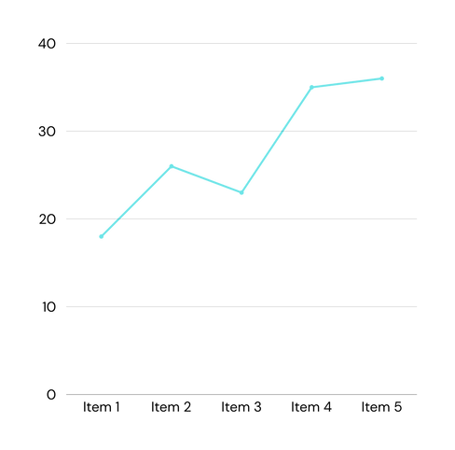

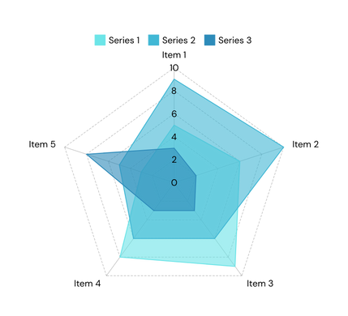


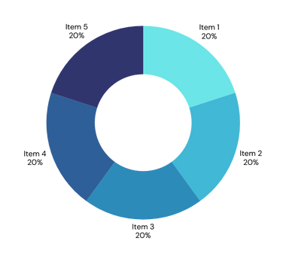
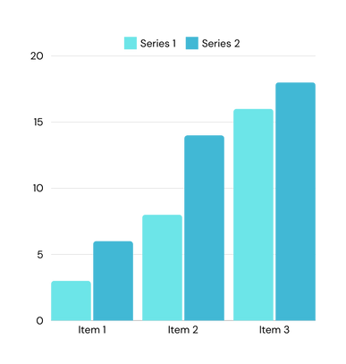





Strategic HR Analytics Dashboard
Presented by Jatin Verma

Slide 2
Dashboard Description
Contains Visual information of employees
Gives insights of employees.
Why they left company
Gives insights of Monthly Salary given to the employee

Slide 3
About Dataset
Dataset is gathered from Kaggle provided by IBM
Mainly divided in three parts
Employee details which includes age,experience,dailyhours , worklife balance ,overtime,marital satus etc.
Monthly salary which includes annual salary , monthly base salary,stock options etc.
Employee attrition

Slide 4
Preprocessing steps
Labeled columns job satisfaction,job environment with string values
Handled wrong data values

Slide 5
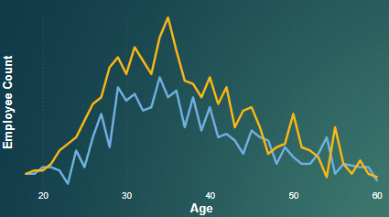
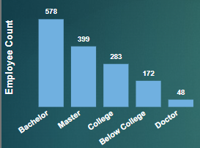
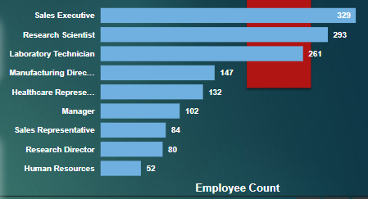
Dashboard Details
line chart and bar chart is used to visualize number of employees with respect to age group ,jobrole and education
Mostly employees are from age group 30-40
Mostly employees are from Sales Executive role

Slide 6
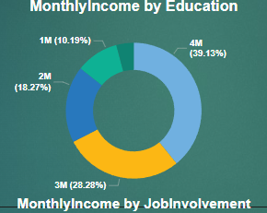
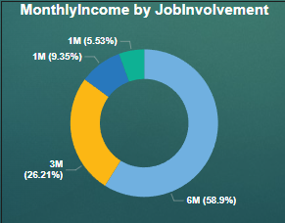
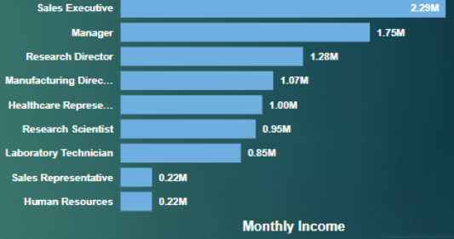
Dashboard Details
In second step monthly salary is analyzed by creating bar graphs and donut chart.
Monthly salary of married employees with high job involvement is highest.

Slide 7
Thank you very much!

